Slide 1
Section 13.1
Sequences
Copyright © 2012 Pearson Education, Inc. Publishing as Prentice Hall.

Slide 2
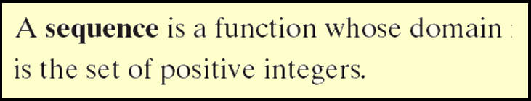
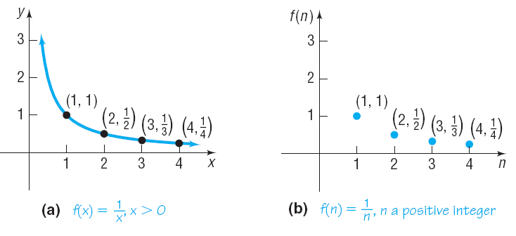
Copyright © 2012 Pearson Education, Inc. Publishing as Prentice Hall.

Slide 3
Copyright © 2012 Pearson Education, Inc. Publishing as Prentice Hall.

Slide 4

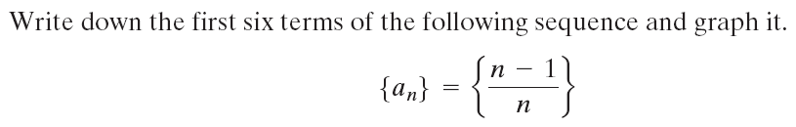
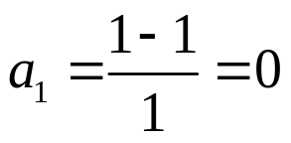
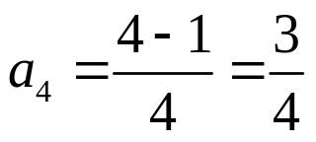
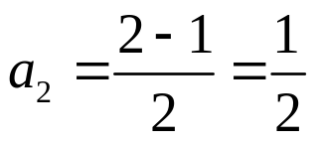
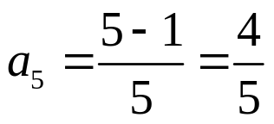
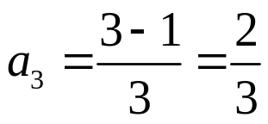
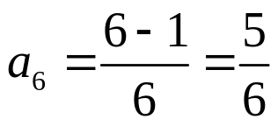
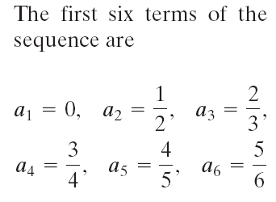
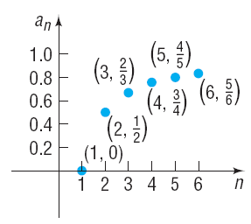
Copyright © 2012 Pearson Education, Inc. Publishing as Prentice Hall.

Slide 5
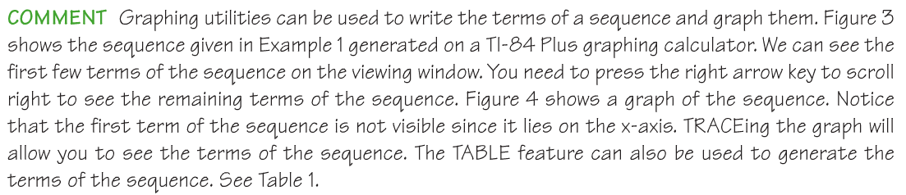
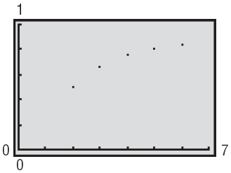
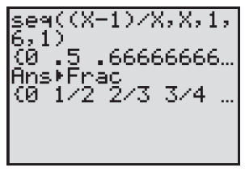
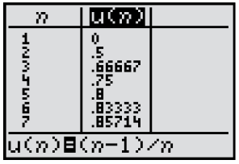
Copyright © 2012 Pearson Education, Inc. Publishing as Prentice Hall.

Slide 6
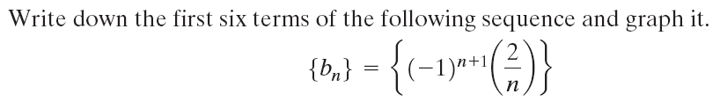
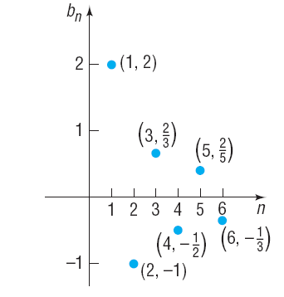
Copyright © 2012 Pearson Education, Inc. Publishing as Prentice Hall.

Slide 7
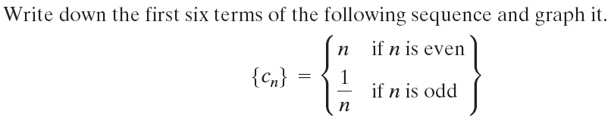

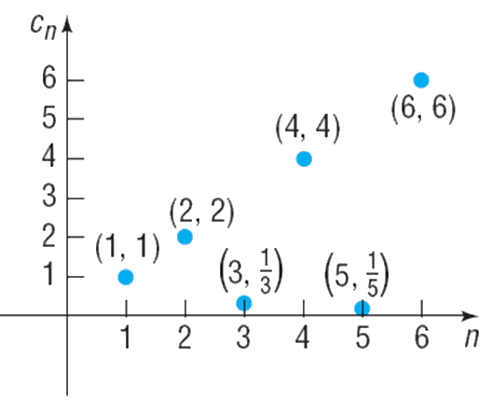
Copyright © 2012 Pearson Education, Inc. Publishing as Prentice Hall.

Slide 8
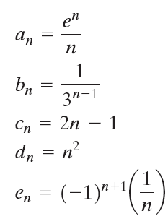
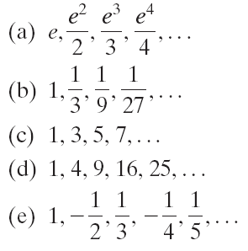
Copyright © 2012 Pearson Education, Inc. Publishing as Prentice Hall.

Slide 9

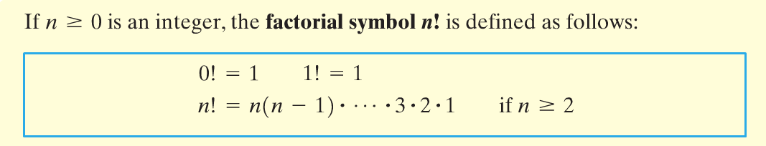
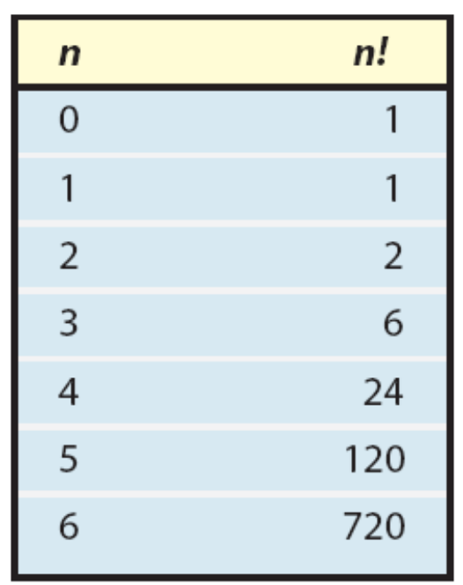

Copyright © 2012 Pearson Education, Inc. Publishing as Prentice Hall.

Slide 10
Copyright © 2012 Pearson Education, Inc. Publishing as Prentice Hall.

Slide 11
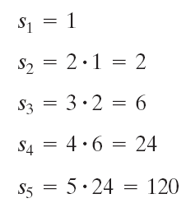
Write down the first five terms of the following recursively defined sequence.
Copyright © 2012 Pearson Education, Inc. Publishing as Prentice Hall.

Slide 12
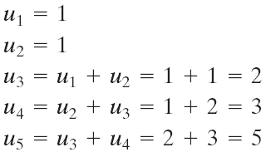
Write down the first five terms of the following recursively defined sequence.
Copyright © 2012 Pearson Education, Inc. Publishing as Prentice Hall.

Slide 13

Copyright © 2012 Pearson Education, Inc. Publishing as Prentice Hall.

Slide 14

Copyright © 2012 Pearson Education, Inc. Publishing as Prentice Hall.

Slide 15
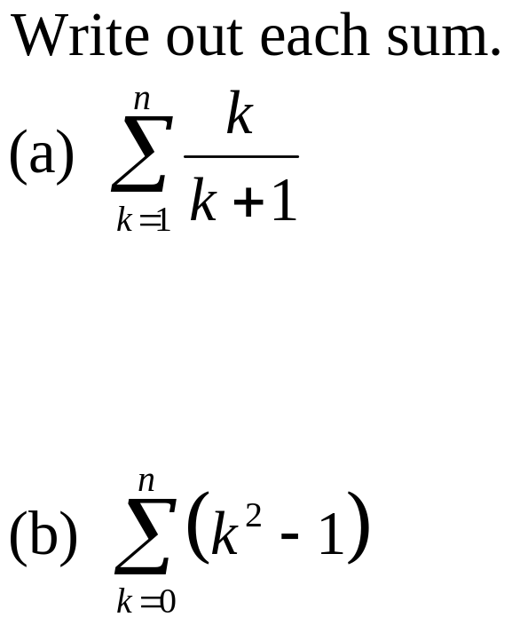
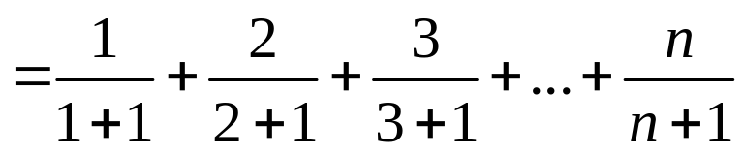
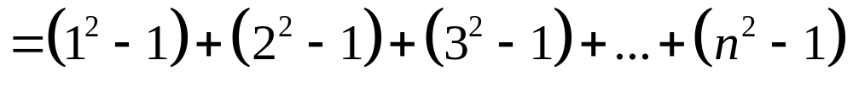
Copyright © 2012 Pearson Education, Inc. Publishing as Prentice Hall.

Slide 16
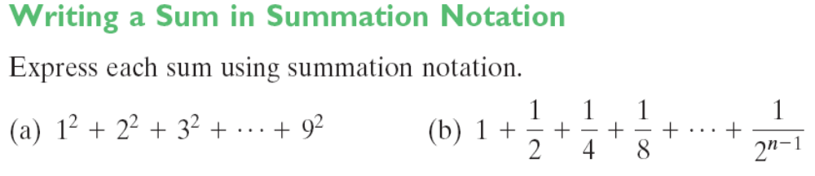
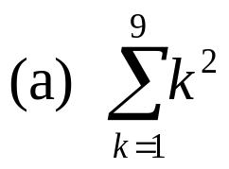
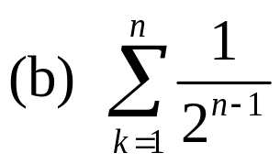
Copyright © 2012 Pearson Education, Inc. Publishing as Prentice Hall.

Slide 17
Copyright © 2012 Pearson Education, Inc. Publishing as Prentice Hall.

Slide 18

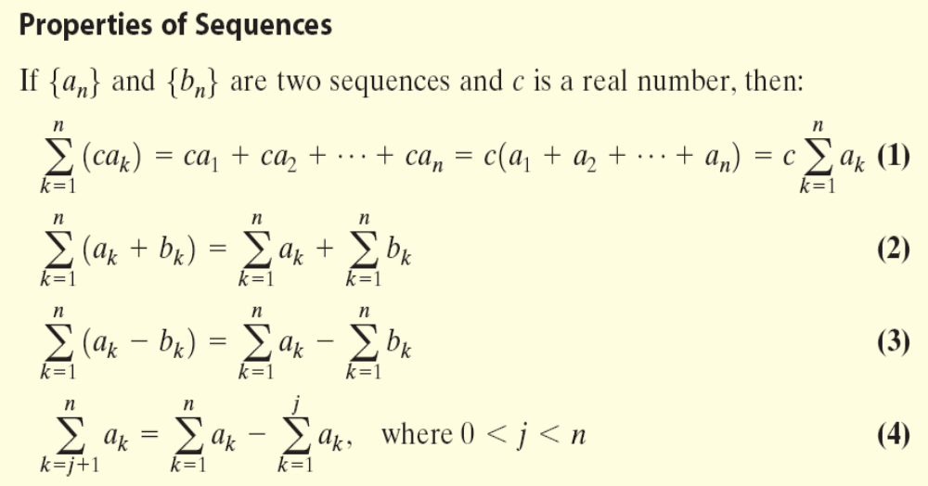
Copyright © 2012 Pearson Education, Inc. Publishing as Prentice Hall.

Slide 19
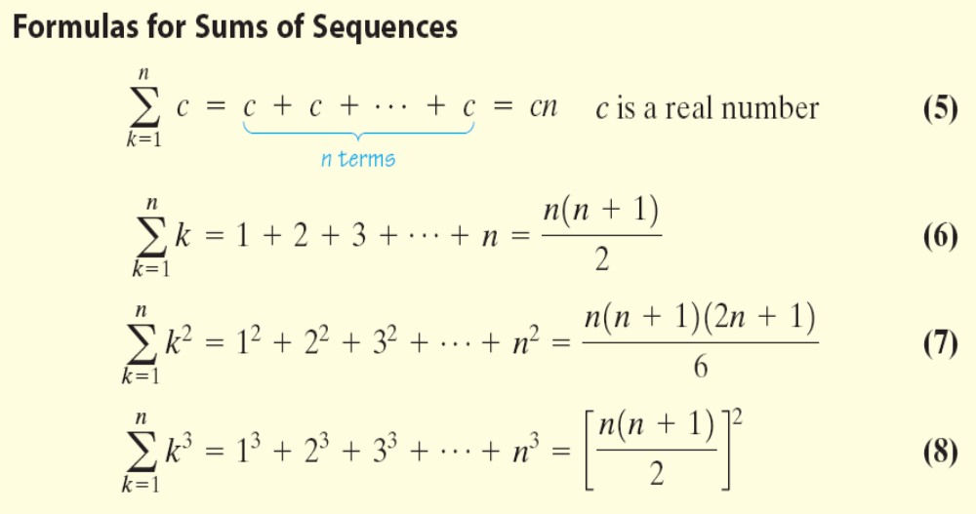
Copyright © 2012 Pearson Education, Inc. Publishing as Prentice Hall.

Slide 20













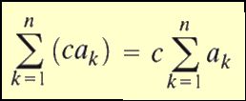

Copyright © 2012 Pearson Education, Inc. Publishing as Prentice Hall.

Slide 21








Copyright © 2012 Pearson Education, Inc. Publishing as Prentice Hall.

Slide 22

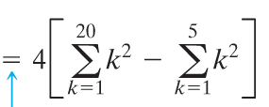

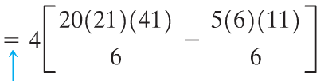

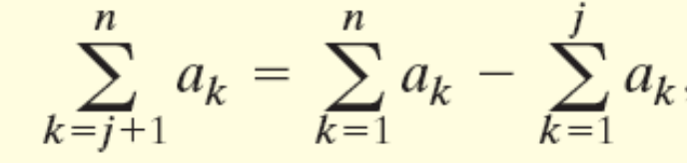
Copyright © 2012 Pearson Education, Inc. Publishing as Prentice Hall.

